Slide 1
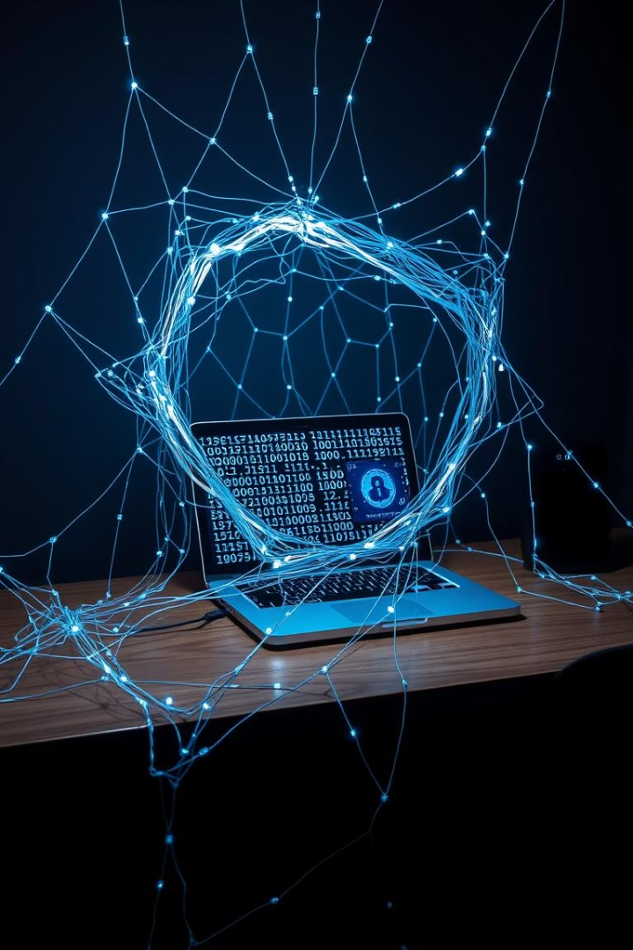
Phishing Awareness: Staying Safe Online
Phishing is the number one cyber threat. Around 3.4 billion phishing emails are sent daily. An astounding 91% of all cyberattacks begin with a phishing email. Global losses from phishing reached $10.2 billion in 2023, according to FBI data. Staying safe online requires constant vigilance.

Slide 2
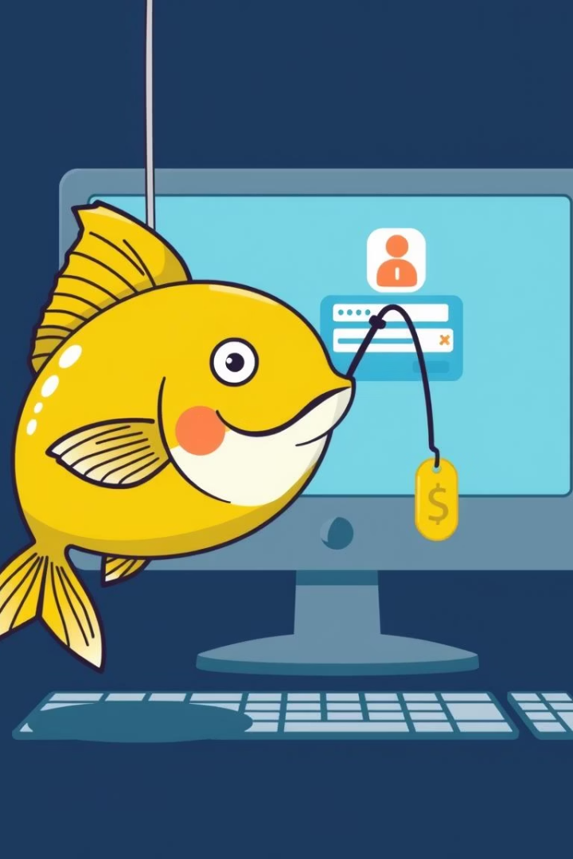



What is Phishing?
Fraudulent attempts
Common Methods
Attack Goals
Attackers aim to steal credentials, install malware, or commit financial fraud.
Phishing is a deceptive attempt to obtain sensitive information from users.
It typically occurs via email, fake websites, social media, or phone calls (vishing).
A common example is a fake bank email requesting account verification. These emails look legitimate to trick you.

Slide 3
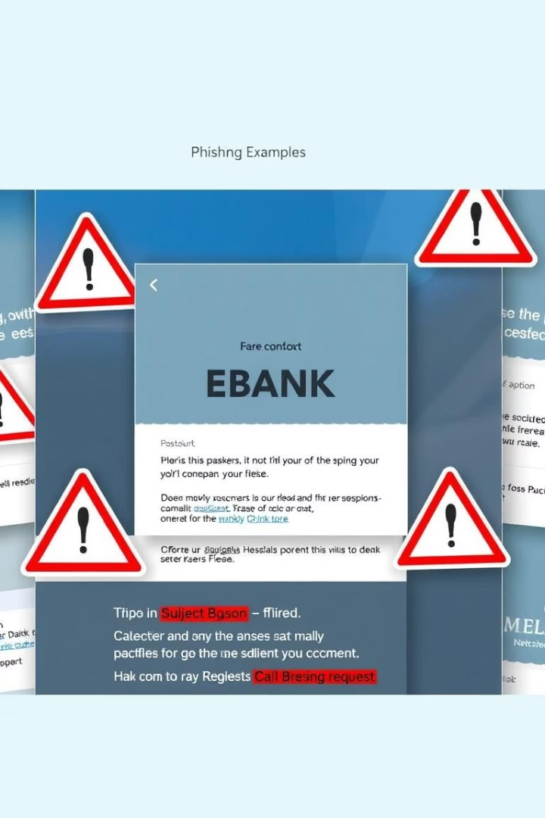
Common Types of Phishing Attacks
Deceptive Phishing
This involves fake login pages or urgent requests.
Spear Phishing
Highly targeted, focusing on specific individuals or roles.
Whaling
Targets high-profile executives and senior management.
Pharming
Redirects users to malicious websites without their knowledge.

Slide 4
Recognizing Phishing Emails
Generic Greetings
Sense of Urgency
Look for "Dear Customer" instead of your name.
Phrases like "Act now!" or "Account suspended."
Typos and Grammar
Mismatched Senders
74% of phishing emails contain errors.
Check if the sender's email address matches the company.
Suspicious Links
Hover over links to preview the URL before clicking.

Slide 5
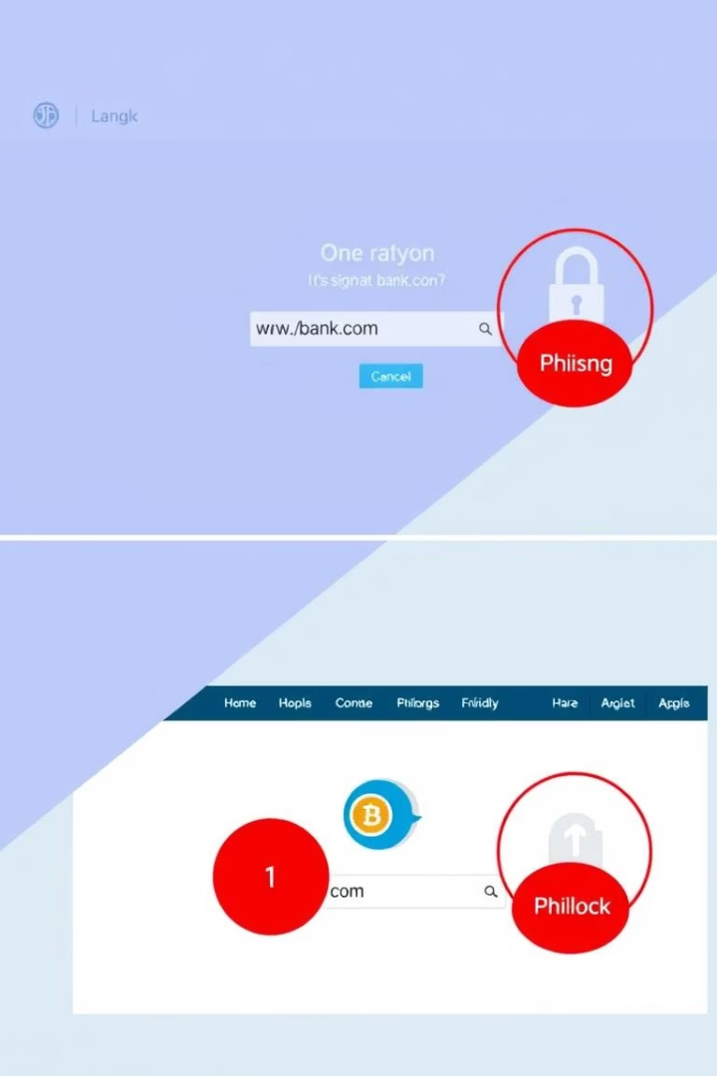
Spotting Phishing Websites
Always check the URL for misspellings like "gooogle.com". Verify that the site uses HTTPS, indicated by a padlock icon in the browser. Be wary of suspicious domain names or missing contact information.
URL Verification
HTTPS Protocol
Ensure the website address is correct and secure.
Look for the padlock symbol in the address bar.
Design Inconsistencies
Beware of poor quality graphics or layout.

Slide 6
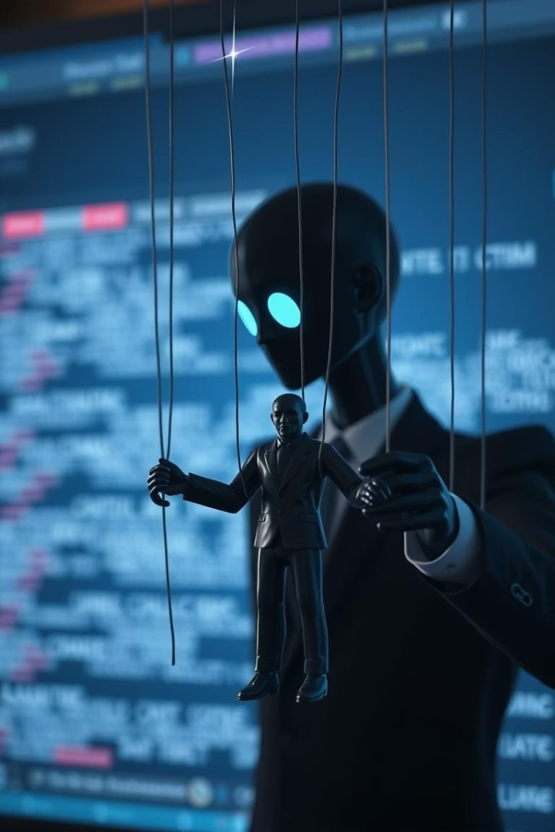



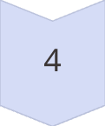
Social Engineering Tactics
Social engineering plays on human emotions like fear, greed, and urgency. Attackers often impersonate authority figures, such as banks or IT support. They build trust by using familiar logos and language. Information gathered from social media, like LinkedIn, can be used to tailor attacks.
Emotional Manipulation
Exploiting fear, urgency, or curiosity.
Impersonation
Posing as banks, IT, or government agencies.
Trust Building
Using familiar brand logos and language.
Information Gathering
Leveraging public data from social media.
An example is "Your account has been compromised. Click here to reset."

Slide 7

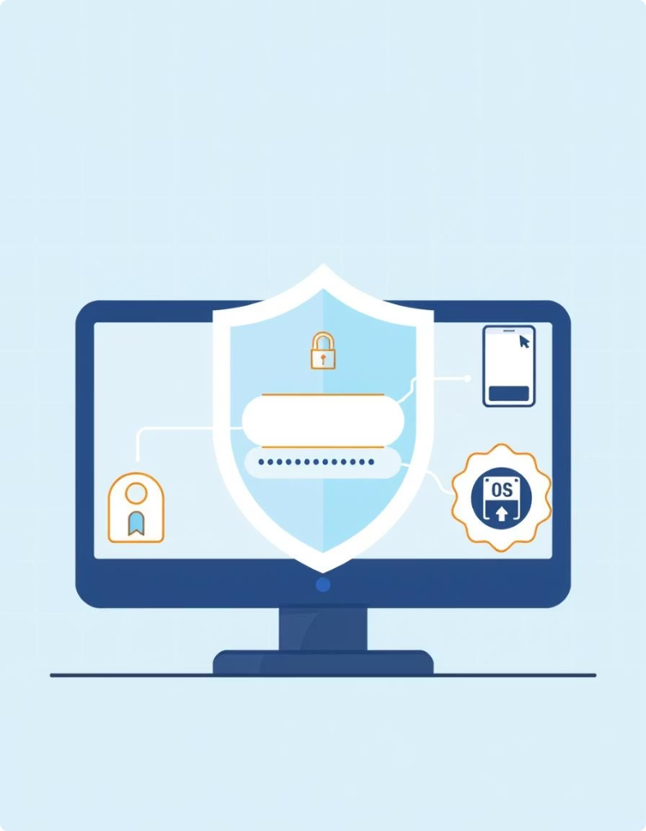
How to Avoid Phishing Attacks
1
2
Verify Requests
Don't Click
Always contact the sender through known channels.
Type URLs directly into your browser instead.
3
4
Strong Passwords
Enable MFA
Use 12+ characters and a password manager.
Multi-factor authentication adds extra security layers.
Keep all your software updated to patch vulnerabilities.

Slide 8

Stay Vigilant, Stay Safe
Report Suspicious Emails
Always alert your IT or security team immediately.
Educate Yourself
Stay informed about new and evolving cyber threats.
Trust Your Instincts
If something feels wrong, it probably is a scam.
Remember, cybersecurity is a shared responsibility. Everyone plays a critical role in protecting themselves and the organization from phishing attacks. Continuous awareness is key.

